Slide 1
Catholic Life and R.E. Newsletter
Compiled by the MiniVinnies

Slide 2
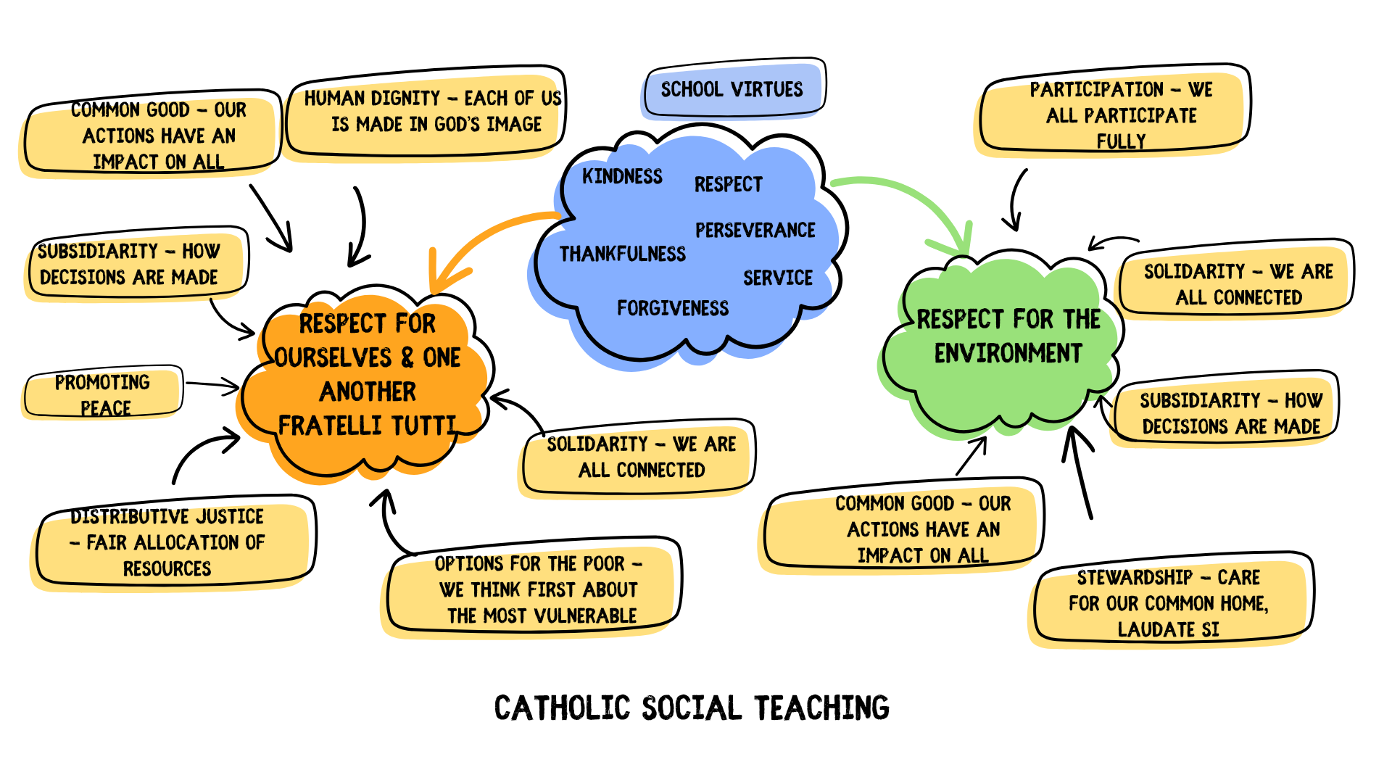
Daily Reflections for this term
Autumn 1
New Beginnings - “Behold I make all things new.” Revelations 21:5
Respect - “Treat others as you want to be treated.” Luke 6:31
Trust in God - “Trust God from the bottom of your heart: don’t try to figure everything out on your own.” Proverbs 3:5
Courtesy - “Do not speak evil of anyone, but be peaceful and friendly, and always show a gentle attitude towards everyone.” Titus 3:2
Thankfulness - “Give thanks to the LORD, for he is good; his love endures forever.”
Psalm 106:1
Autumn 2
Hope - “Those who hope in the LORD will renew their strength. Isaiah 40:31
Patience - “Be humble and gentle in every way. Be patient with each other and lovingly accept each other.” Ephesians 4:2
Justice - “For the word of the Lord is right. And all his work is done in truth. He loves righteousness and justice. Psalms 33:4-5
Peace – “Do not let your hearts be troubled and do not be afraid.” Jon 14:27
Joy – “A joyful heart is good medicine, but a crushed spirit dries up the bones.” Proverbs 17:22
Catholic Life & Mission
Collecting for Sevenoaks Loaves and Fishes Food Bank
Singing and Ensemble Playing at local care homes
Carol Singing as part of the Sevenoaks Town Community
Education Sunday – singing at Sunday Mass
School Council (Eco-Committee)
Butterfly Conservation Assembly
Eco Afternoon – tidying up the school grounds and planting for winter
Supporting the PTA with the new playground ‘adventure’
Woodland Trust Awards
Catholic Social Teaching
Prayer (prayer room etc)
Celebration of the Word
Year 4 – Parable of the Workers in the Vineyard. Matthew 20:1-16a
Year 2 – God invites everyone to His great heavenly celebration. Matthew 22:1-14
Year 1 – Give to the government what is required while giving their whole hearts and lives to God. Matthew 22:15-21
Year 3 – Parable of the Talents. Matthew 25:14-30
Year 5 – Christ the King. Loving and helping others is the same as loving and helping Jesus. Matthew 25:31-46
Year 6 – First Sunday of Advent. Mark 13:33-37
Other Special Events
September – KCSP Beginning of Year Mass
October – Month of the Rosary.
November – All Saints and All Souls
December – EYFS and KS1 Nativity, KS2 Carol Service

